Slide 1
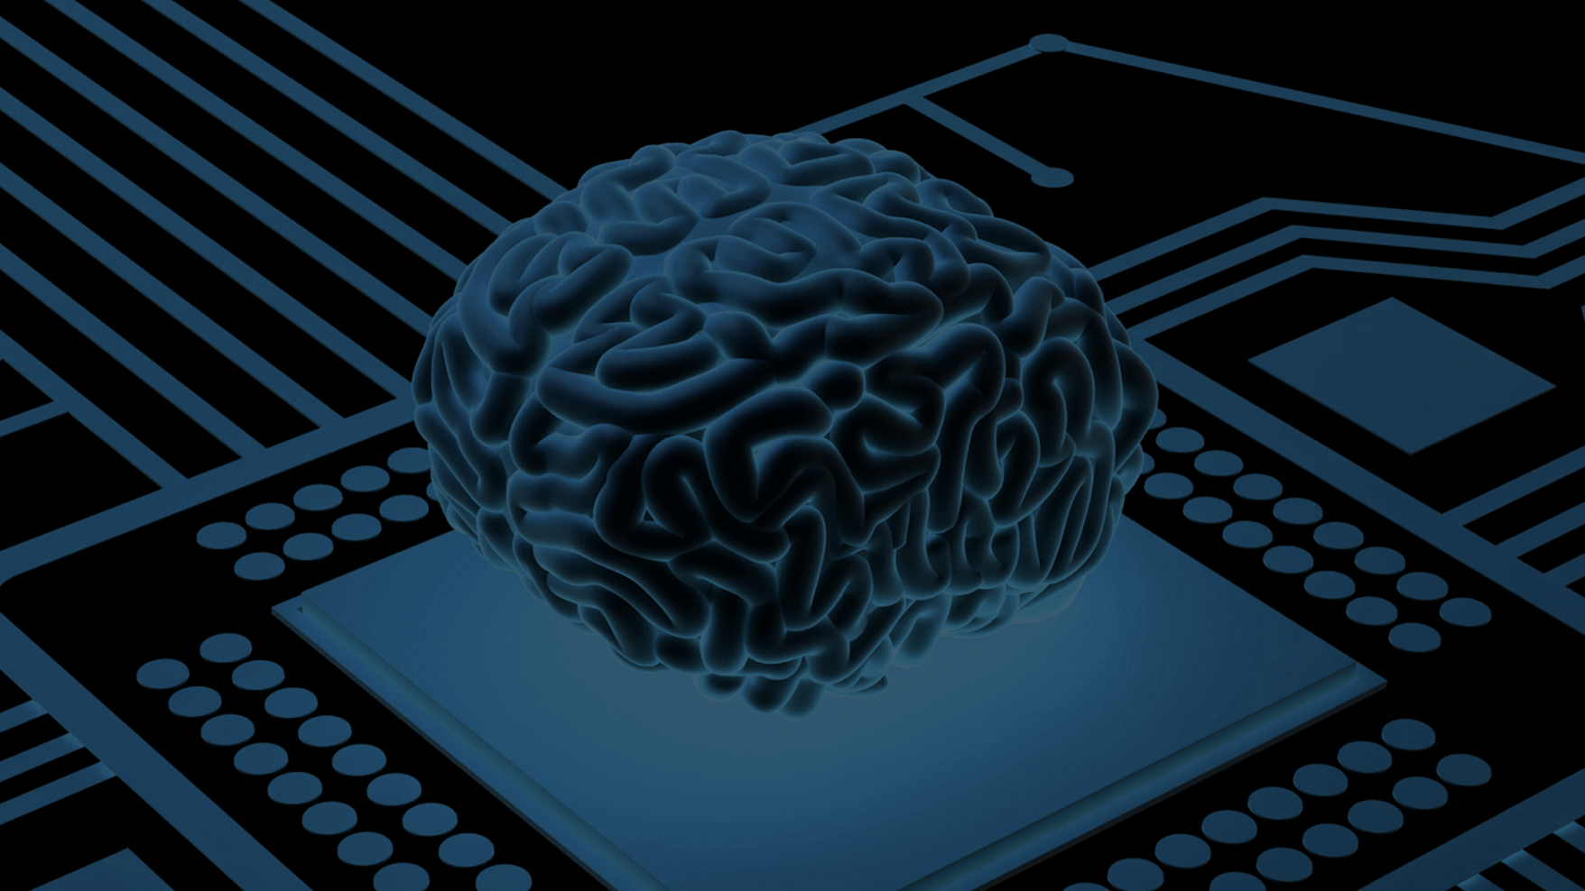
CruX Team 2 - RC Car
Alisha Ly, Anish Thalamati, Audrey Ngai, Avantika Aggarwal, Hanna Boughanem, Mateo Umaguing, Paige Lee, Sree Nagaraj, Srivarsha Rayasam

Slide 2
Narrative
Model car ~ wheelchair
Steady State Visual Evoked Potential (SSVEP)
SSVEP classification -> model car control

Slide 3
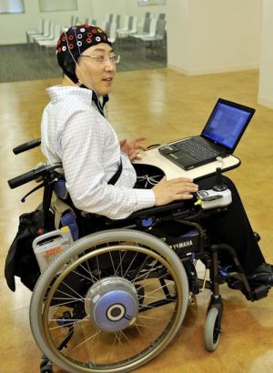
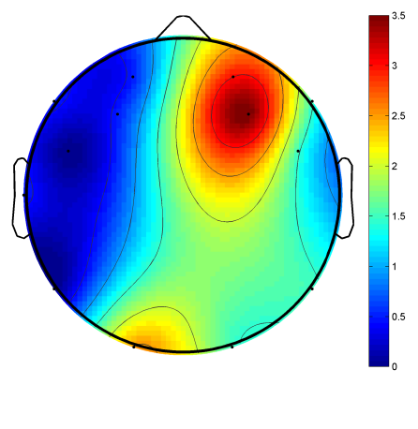
Significance
Paraplegic Application
SSVEP Research

Slide 4
Overall Aim
Develop a brain-computer interface (BCI) that can control the movement of a model car.

Slide 5
Specific Aims
Successfully collect EEG signals via OpenBCI headsets.
Create a brain-computer interface to classify SSVEP signals using analytical or ML methods.
Navigate a model car through a maze via a brain-computer interface.

Slide 6
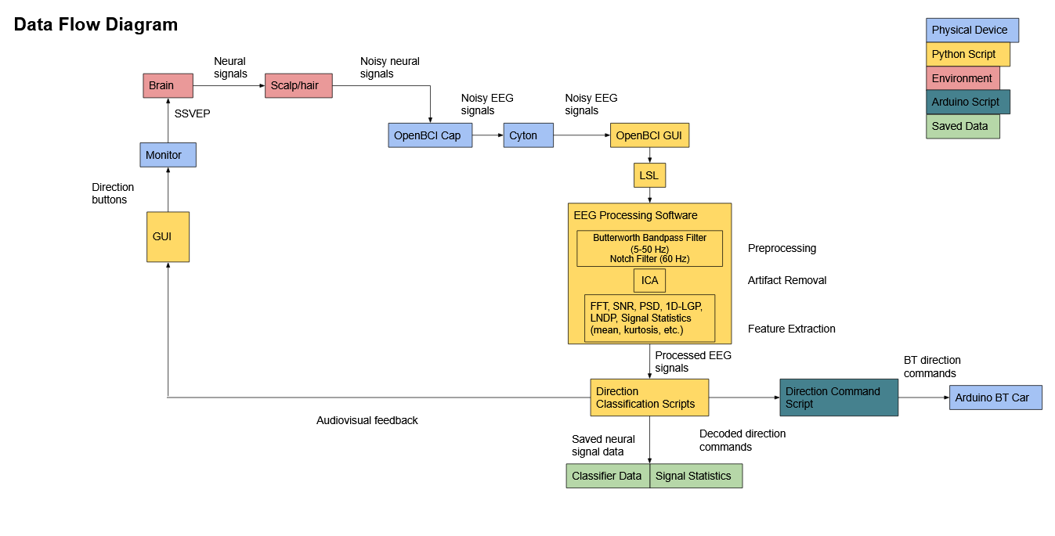

Slide 7
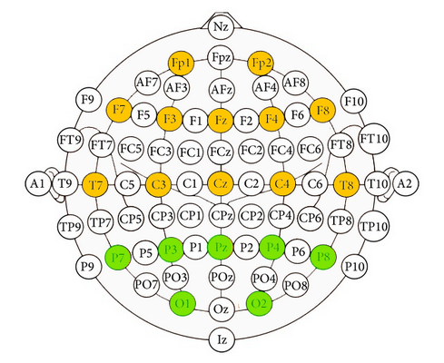
Fig. 2 - Electrode Channels of Interest

Slide 8
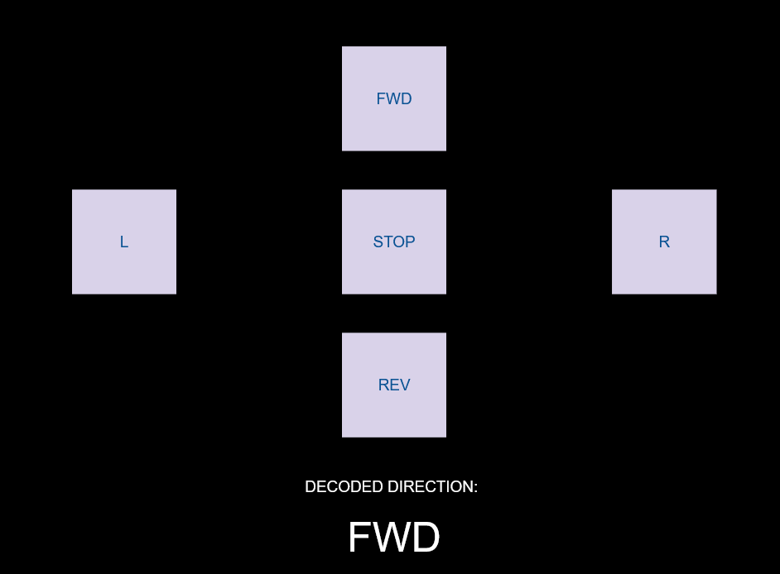
Fig. 3 - Graphical User Interface

Slide 9
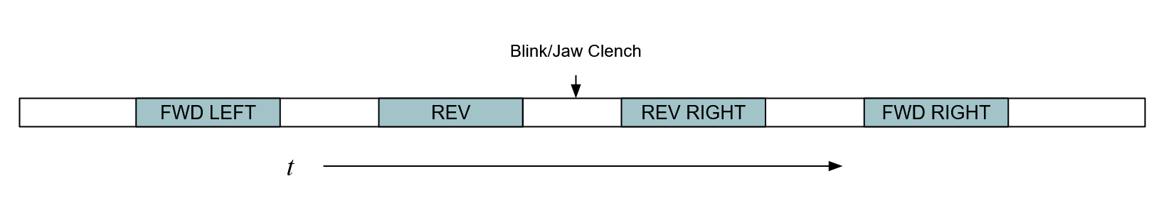
Fig. 4 - Training Session Example
Notes:
Discuss signal processing and feature extraction techniques

Slide 10
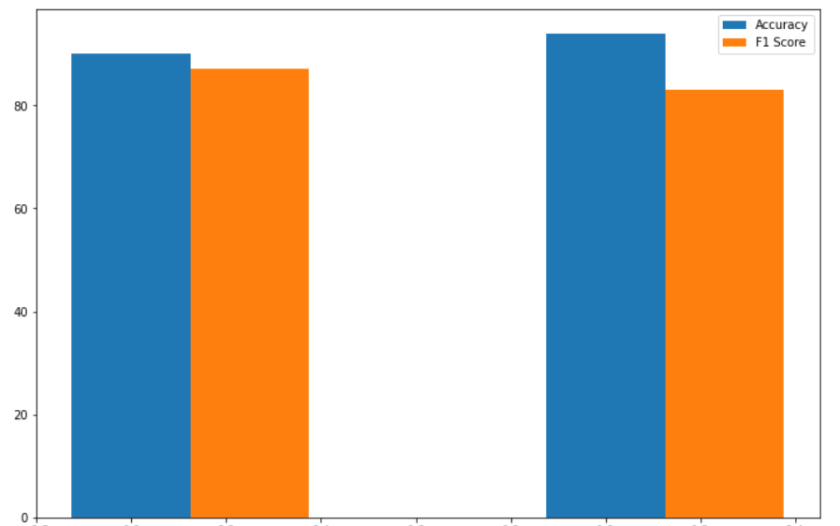
Fig. 5 - Simulated Classifier Accuracy and F1 Scores
Notes:
Discuss ML methods

Slide 11
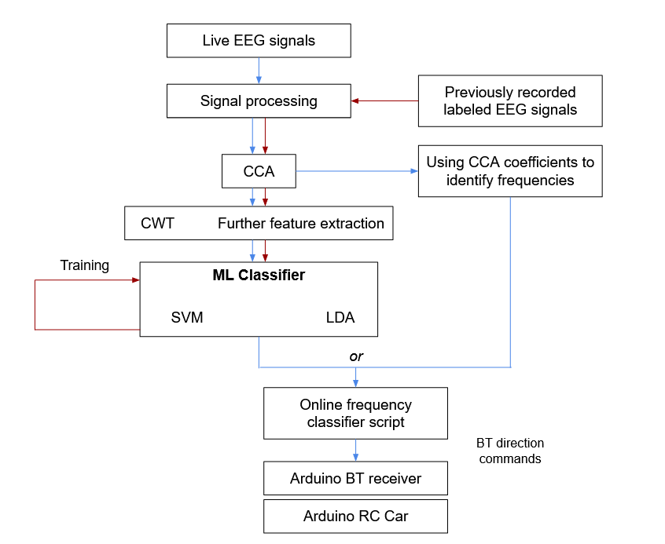
Fig. 6 - SSVEP Classification Schematic
Notes:
Discuss signal processing and feature extraction techniques

Slide 12
References
Amareswar, Enjeti, et al. “Design of Brain Controlled Robotic Car Using Raspberry Pi.” 2021 5th International Conference on Trends in Electronics and Informatics (ICOEI), 2021, https://doi.org/10.1109/icoei51242.2021.9452957.
Hongtao Wang, et al. “Remote Control of an Electrical Car with SSVEP-Based BCI.” 2010 IEEE
International Conference on Information Theory and Information Security, 2010, https://doi.org/10.1109/icitis.2010.5689710.
Hu , Li. Chapter 2 EEG: Neural Basis and Measurement - Springer. Edited by Zhiguo Zhang, Springer, https://link.springer.com/content/pdf/10.1007/978-981-13-9113-2_2.pdf.
Ma, Pengfei, et al. “A classification algorithm of an SSVEP brain-Computer interface based on CCA fusion wavelet coefficients.” Journal of Neuroscience Methods, vol. 371, 1 April 2022, https://doi.org/10.1016/j.jneumeth.2022.109502
Rashid, Mamunur, et al. “Current Status, Challenges, and Possible Solutions of EEG-Based
Brain-Computer Interface: A Comprehensive Review.” Frontiers in Neurorobotics, vol. 14, 2020, https://doi.org/10.3389/fnbot.2020.00025.
Wang, Hongtao, et al. “The Control of a Virtual Automatic Car Based on Multiple Patterns of
Motor Imagery BCI.” Medical & Biological Engineering & Computing, vol. 57, no. 1, 2018, pp. 299–309., https://doi.org/10.1007/s11517-018-1883-3.
Yu, Yang. “Toward Brain-Actuated Car Applications: Self-Paced Control with a Motor Imagery-Based Brain-Computer Interface.” ScienceDirect, 25 Feb. 2016, https://www.sciencedirect.com/science/article/pii/S0010482516302074?via%3Dihub.
Zhao, QiBin, et al. “EEG-Based Asynchronous BCI Control of a Car in 3D Virtual Reality
Environments.” Chinese Science Bulletin, vol. 54, no. 1, 2009, pp. 78–87., https://doi.org/10.1007/s11434-008-0547-3.

